Slide 1
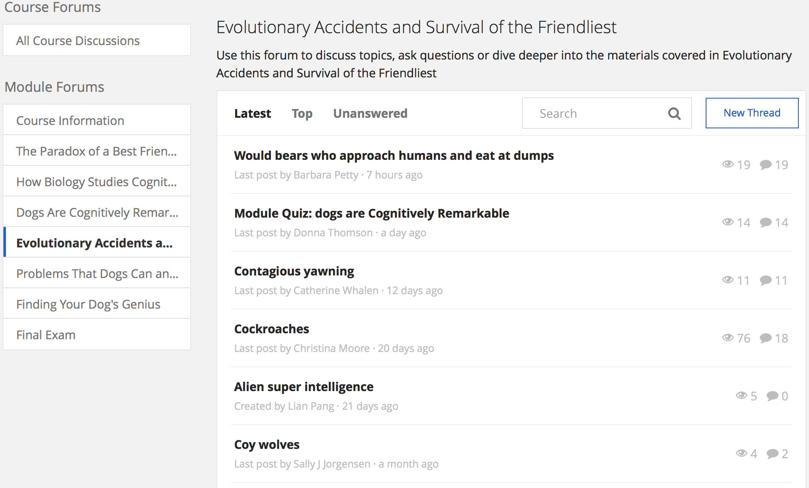
1
1
1
2
1
1
2
1
1
2
1
1
2
2
2

Slide 2
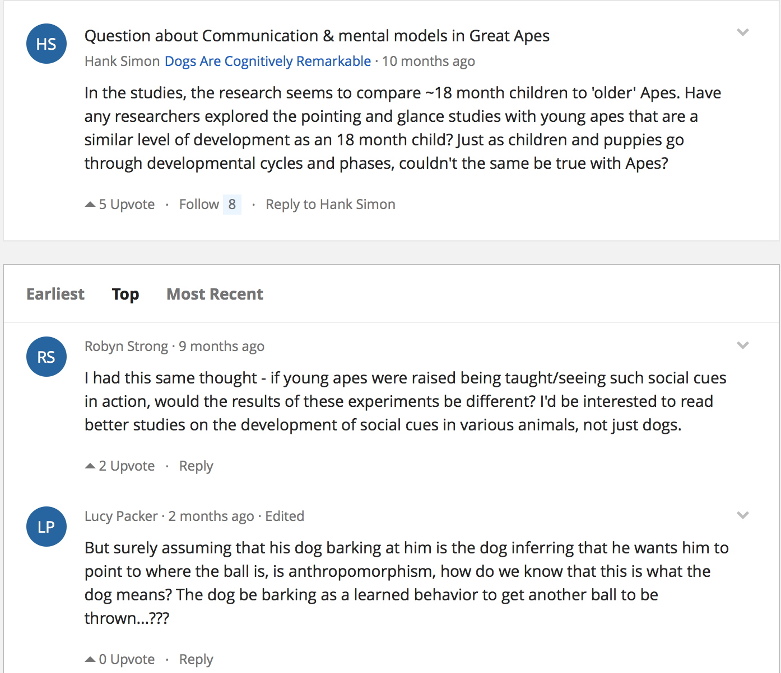
3a
3c
3b
3c
3b
3c

Slide 3

3b
3c
3d
3e
3d
3e

Slide 4
3a
Relations with Content
3c
3b
3c
3b
3c

Slide 5
3b
Relations with Content
3c
3d
3e
3d
3e

Slide 6
1
1
1
2
1
1
2
1
1
TALK_PAGE_HAS_DISCUSSION
2
1
1
2
2
2

Slide 7
3a
3c
DESCENDANT
3b
3c
3b
3c

Slide 8
3b
3c
COMMENT
3d
3e
3d
3e

